Slide 1
Recognition and appreciation

Slide 2
Why is this topic important?

Slide 3
The difference between appreciation and recognition

Slide 4
Recognition v. Appreciation
Recognition is about giving positive feedback to an employee based on the results of their performance.
Appreciation is about understanding and acknowledging the inherent value of a person.
It isn’t about their accomplishments; it’s about their worth as a colleague and human.
Recognition emphasizes what people do; appreciation emphasizes who they are.
Both are needed when creating a healthy company culture.

Slide 5
Recognition v. Appreciation
“I have to say that the single most important lesson I learned in 25 years talking every single day to people was that there’s a common denominator in our human experience….The common denominator that I found in every single interview is we want to be validated. We want to be understood.”
~Oprah Winfrey
Why does this matter?
Recognition and appreciation are given for different reasons.
Even when we succeed, there will be failures and challenges along the way.
If you focus solely on praising positive outcomes you miss out on opportunities to appreciate your team.

Slide 6
Recognition v. Appreciation
By showing an employee they’re truly appreciated, they’ll gain the confidence and energy to consistently increase productivity.
Vanessa Thurston, Interim Vice President & Head of Talent Management for Samsung Electronics America, says to treat your employees as customers.*
Think of your team members in terms of how you can create a valuable experience for them, improve their journey, and be empathetic to how they feel.
*Source: Baudville.com

Slide 7
Why are recognition and appreciation important?

Slide 8
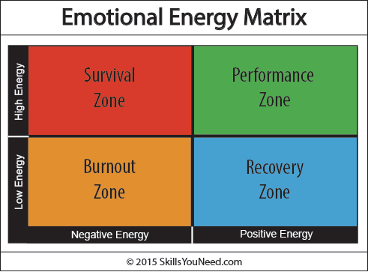
Why It Matters
Happy employees are more productive.
A recent study by economists at the University of Warwick found that happy employees are on average 12% more productive than unhappy employees.
Sharing appreciation also makes the giver feel happier!
Research by Shawn Anchor, author of The Happiness Advantage, indicates that the brain works better when a person is feeling positive.
We’re more creative and better at solving problems.

Slide 9
Why It Matters
Happy workers are more effective collaborators.
Showing appreciation for ideas and suggestions makes it more likely that employees will generate and share new ideas in the future.
Appreciation increases trust.
According to Forbes, 90% of employees receiving recognition or thanks from their boss had higher levels of trust in that boss.

Slide 10
Why It Matters
Recognition leads to better retention.
60% of workers surveyed by Forbes said they put the most value on being appreciated by management.
The worst qualities of a boss were reported as being emotionally distant and uncommunicative. Examples included:
failing to give credit to workers (32% of respondents)
rarely giving praise or expressing support (28%)
failing to help employees with promotion (24%)
viewing workers as replaceable (13%)
63% of employees (surveyed by Bonusly) who are recognized are very unlikely to look for a new job.

Slide 11
Why It Matters
Appreciating employees leads to better customer service.
Research by Quantum Workplace found that leading customer service organizations report 60% more engaged employees.
Social media makes it easy for customers to know how employees are treated, and that matters to customers when making purchasing decisions.
A Forbes survey found that 80% of Americans feel that companies do not currently share enough of their success with employees.
Notes:
Ask: can you think of a retailer or company you stopped going to because of the way their employees were treated?

Slide 12
When to recognize and appreciate

Slide 13
When to Recognize and Appreciate
Overcomes a challenge (e.g., a difficult customer request)
Successfully assists a customer
Supports a team member on a project/assignment
Identifies an opportunity for improvement or streamlining
Learns something new
Demonstrates how much of a measurable impact they’re having on the department

Slide 14
When to Recognize and Appreciate
Achieves a goal
Know what goals your employees have and how they’re progressing
Demonstrates company values
How are they being a good ambassador for the brand?
Demonstrates effort at completing a difficult task
Don’t only award success—effort also matters!
Give props for taking a risk, even if it doesn’t end in success.

Slide 15
When to Recognize and Appreciate
A recent survey by the social network Linkagoal found that fear of failure plagued 31% of 1,083 adult respondents.
Fear of failure makes people less likely to take risks and to take responsibility for their work.
You can overcome this by recognizing effort and strategic risk-taking.

Slide 16
When to Recognize and Appreciate
Make sure the recognition is deserved, not just cursory. Otherwise, it will feel insincere.
Recognize regularly, not just at annual reviews.
Think about what your recipient might want:
Are they comfortable with public recognition?
Would they prefer an email instead of an in-person compliment?
Encourage employees to recognize each other.

Slide 17
Types of recognition and appreciation

Slide 18
What do employees want?
In a study of 400,000 employees, Quantum Workplace found that the most important form of recognition is a pay increase.
Other items in the top 5:
new learning/training opportunities
a spontaneous cash bonus
more flexibility or autonomy
time off
Team celebrations and personalized gifts such as a plaque or company merchandise ranked last.
Notes:
Transition to next slide: employees can use High Five points to get monetary rewards / tangible items

Slide 19
Informal Recognition and Appreciation
Words of affirmation
Thank you
Good job today
I appreciate…
The execs really liked the work you did on…
I know X was challenging, and you did a great job!
The way you handled X was great! You were so calm and collected.
Your work has made a difference here.

Slide 21
Informal Recognition and Appreciation
Write a note
Discuss good work in one-on-one meeting
Point out specific things that were done well when giving feedback
Send an email and cc next level manager
Create an Employee All Stars bulletin board or white board
Track team wins and progress toward goals
Bring a special cup of coffee when you know they have had a long day

Slide 22
Informal Recognition and Appreciation
“People don’t care how much you know until they know how much you care.”
~Teddy Roosevelt
Listen
You can show an employee you appreciate them by just listening to what they have to say.
Give a choice and a voice
Listen to their ideas or concerns and actually take action on them.
Recognize non-work achievements

Slide 23
Job-Related Rewards
Stretch assignments
Additional responsibilities
Get their choice of assignments
Lead a project or task
Attend higher-level meeting
Workshop/conference attendance
Act on employees’ suggestions and ideas
Employees appreciate the acknowledgement that they had a good idea

Slide 24
Remember…
It's not enough to create a program; keep it fresh and tie it to organizational values.
ATD researchers found that impersonal recognition programs can lead to workers feeling underappreciated.
“Virtual teams, decentralized work, and new technology integration require equally progressive approaches to recognition."

Slide 25
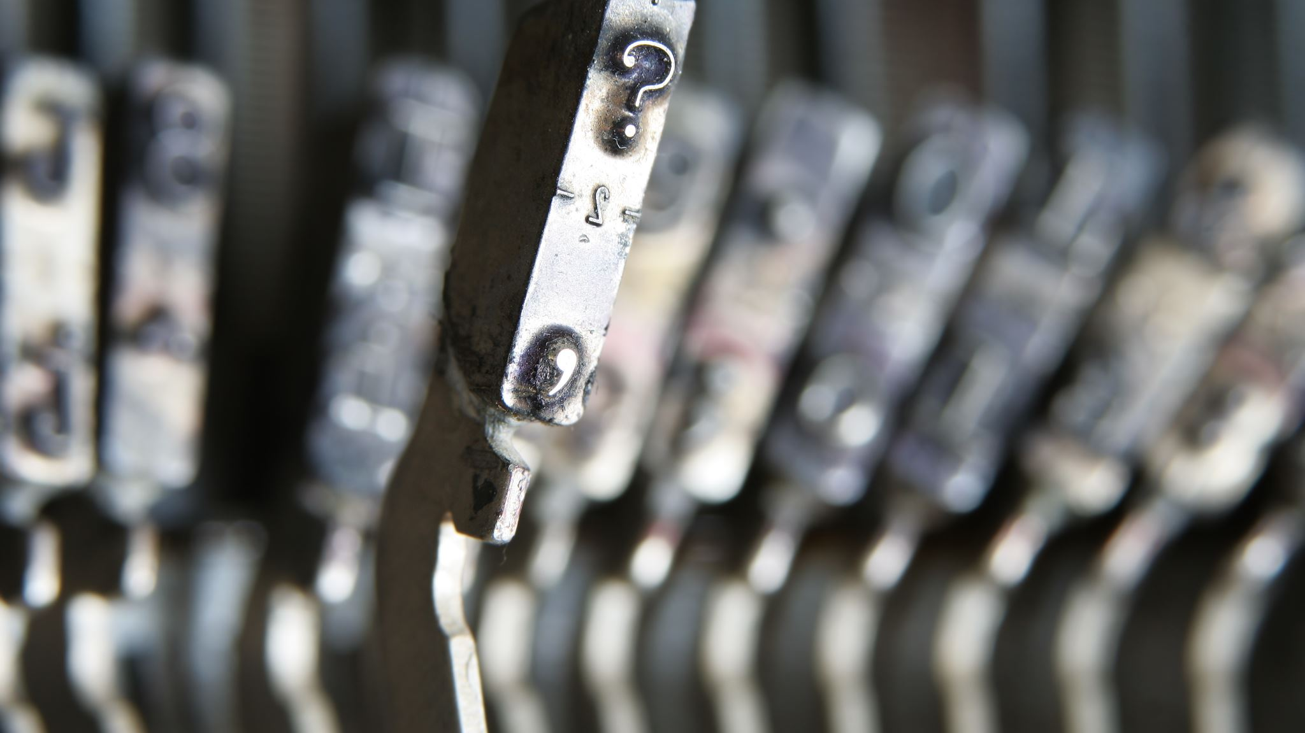
QUESTIONS?

