Slide 1
Discovering Customer Needs
Kimberly Young

Slide 2
Today’s topics…
Communicating and working together across departments
Strategies for questioning customers and discovering their needs
Applying skills across business lines
Using follow-ups to get the job done

Slide 3
Is your ideal customer…
AGREEABLE
SH
GGRESSIVE
FRUGA
XPERT
AGER
RAS
IRM
A S T Y
ICH
RUMPY
OUNG
LUC
ICH
ONCHALANT
LOYAL
ROUBLE
SIMPL
VERLOOKED
Y
IRECT
NQUISITIVE
APPY
NTENT
RUDENT
USY
HOUGHTFUL
TABLE
XPERIENCED
RUSTING
Notes:
Pick out 3 words that would describe your ideal customer.
Ask a couple of participants to share one word they chose and why.

Slide 4
Communicating and working together

Slide 5
Notes:
When it comes to effectively questioning your customers to discover new needs, it is important to remember that Salem Five is one big team.
This isn’t just about working with people on your own team / in your business line; colleagues in other departments are also part of your “team.”

Slide 6
Communicating and Working Together
Employees gain a holistic view of the organization’s work.
When each department shares how it does its work, you have the opportunity to look at the way you do work through your colleagues’ fresh set of eyes.
Good relationships create opportunities.
Effective interpersonal work relationships form the cornerstone for success and satisfaction with your career.
Notes:
Why is interdepartmental communication and teamwork important?
Holistic view—
All departments working together to fulfill bank’s mission and serve customers
Gain important context about your job and goals

Slide 7
Notes:
“Relationship management” isn’t just about customers; to provide the best service, you need to have good working relationships with colleagues from around the bank
A good relationship requires trust, mutual respect, mindfulness, welcoming diversity, and open communication

Slide 8
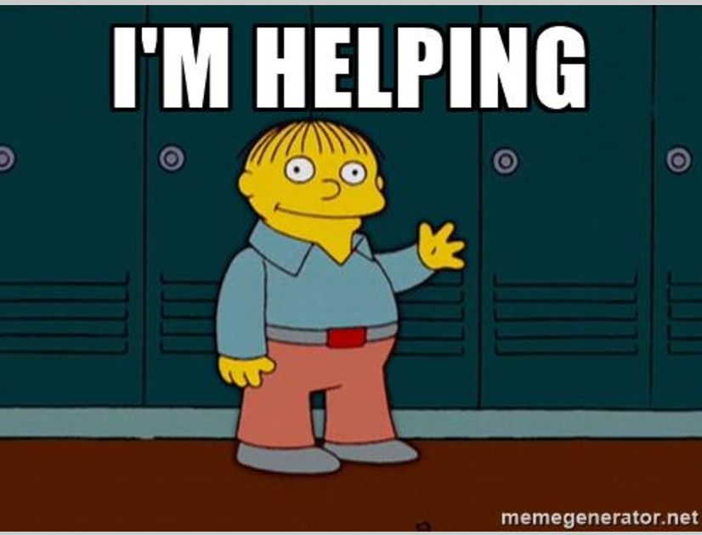
Communicating and Working Together
Ask questions and listen actively.
Nonverbal communication matters.
Always speak positively and honestly.
Offer assistance.
Help others be the best they can be.
Share your knowledge.
Know when to ask for assistance.
No one is an island; we can all help each other.
Let others share their knowledge.
Appreciate each employee's role and appreciate what you do for each other.
Share and celebrate accomplishments.
Give feedback on other people’s work.
Congratulate others on a job well done.

Slide 9
Communicating and Working Together
Find out what you share.
Find common goals and interests.
Don’t play the blame game.
Own your mistakes and avoid pointing fingers.
Explain the cause rather than blaming it on others.
Schedule time to build relationships.
Set up meetings, lunches, or other time to learn how to work together.
Keep your commitments and never blindside anyone.
Make sure they know what to expect and that they can count on you.
Respect people’s time.

Slide 10
Notes:
By communicating and having relationships with other team members, we can make sure that every customer has the same experience and the same message
This is an important part of building brand loyalty

Slide 11
Communicating and Working Together
PERSONAL
BANKING
TEAM
Make sure all needs are met throughout their relationship with us.
Don’t give them a reason to go somewhere else!
Notes:
We often tell our retail employees to communicate to their customers their desire to be the customer’s personal banker; in reality, people from around the bank need to come together to create a personal banking team for each customer. By partnering with other business lines, we ensure that the customer never needs to go to another bank.
This is all part of being a brand ambassador

Slide 12
Strategies for identifying customer needs
Notes:
Slide #14

Slide 13
Strategies
It is relatively rare for a customer to spontaneously communicate their needs and expectations to the company.
When a bank representative is able to help a customer achieve a significant life goal, that customer’s level of trust skyrockets!
Many salespeople focus too much on the solution. They try to solve problems too quickly, and offer solutions before the customer is fully bought in.
The art of delivering a quality solution starts way before the pitch; it comes from first taking the time to clearly define the customer’s problem.
Notes:
Why is it helpful to use strategies to identify customer needs?

Slide 14
The
DRIIIL
Technique
Notes:
The DRILL technique is a great way to plan any sort of meeting, but it works particularly well when you’re planning to dig deep to discover what your customer needs.

Slide 15
The DRIIIL Technique
Direction: set the direction of the meeting
“What do you want to get out of this meeting?”
“What’s the most important thing you want to achieve today?”
Notes:
Most salespeople will start the meeting with their own objectives. Asking the customer to state their objectives is a professional and assertive way to start the meeting. It allows you to tick off all of their agenda points. And, interestingly, the customer almost always replies with their biggest problem, need or pain.

Slide 16
The DRIIIL Technique
Reality: explore their current situation, probing for any issues
“Tell me about your current set up in regard to…”
“What challenges are you facing, in regard to…?”
Notes:
Asking leading questions about their current issues (specific to areas you can help), allows you to quickly pick up on any challenges, problems, or needs they have. It allows you to quickly understand how you can best help them.

Slide 17
The DRIIIL Technique
Issue: drill down into the issue
“Tell me more about that.”
“Explain to me how that…”
“What specifically do you mean by…?”
Focus on using open questions at this stage of the process.
Who… What… When… Where… Why… How….
Notes:
Often a surface level complaint is not actually the real problem. These questions help you dive deeper under the surface and define the customer’s real issues.
These questions also create trust and rapport as the customer feels listened to and understands that you care.

Slide 18
The DRIIIL Technique
Cause
Effect
Effect
Impact: find the impact
“How does that affect your business?”
“What impact does that have on your business?”
“How does that impact you – your team, your profit margins, your customers?”
Notes:
These questions are some of the best questions in sales. This is because they shift the conversation away from the problem (the rational business issue) and towards the impact (the emotional, personal impact). Talking about the impact allows you to fully understand the bigger picture and open up the emotional side of the brain; a key influencer in all purchasing decisions.

Slide 19
The DRIIIL Technique
Imagine: get the customer to paint a picture of the solution
“In your mind, what would help to resolve these issues?
“What does a good solution look like?”
“How could you see us working with you?”
“What return on investment are you looking for?”
Notes:
If a customer tells you exactly what they want, then you know exactly what to offer them as a solution. Plus, if a customer starts to visualize your solution in their head, they have already started to imagine working with you. They are bought into the idea as they helped to create it.

Slide 20
The DRIIIL Technique
Lead: how can I help?
“So, how can I help with this issue?”
They tell you exactly how you can help
-or-
They say, “I don’t know, you tell me!”
Notes:
Although this may seem like a strange question to ask at the end of the questioning process, it really works. This is because customers tend to respond to this question in one of two ways:
•They tell you exactly how you can help (i.e. pitching your solution back to you)
•They say, “I don’t know, you tell me” (leading you nicely into the presentation of your solution)

Slide 21
The 5 Whys Technique
Discover what needs people don’t even know they have; needs that no one has recognized before.
Keep asking why until you get at the root cause of the problem and not a symptom.
It’s called “Five Whys” because you often have to ask 5 times before you get to the point where you can make a change that addresses the problem.

Slide 22
Assessing the customer’s need
How do you assess the customer’s needs?
By asking the right questions
by paying attention to the process

Slide 23
Types of questions
The Diagnostic question:
What is the problem/concern/issue? Ask questions that reveal the potential root cause.
What products or services is needed?
What information do you know?

Slide 24
Types of questions
The Metric question:
Getting the customers to buy-in. Align the customers concerns and any potential solutions to what matters– time, quality, cost and output
What ideas/resources the customer is willing to provide?
How far along are you in the process?

Slide 25
Types of questions
The Performance Gap question:
What is the potential solution here? What is the employee not doing that he should have been doing to bridge the gap?
What are the next steps involved?

Slide 26
Types of questions
The Timing question:
The longer the problem persist the more likely it is to occur. Gain valuable insight to the timing of the problem.
What steps have been made to rectify the issue?
What are the procedures involved?

Slide 27
Types of questions
The Scoping question:
You need to be able to understand the size and impact of the customer’s needs.
How has this affected you financially?
How much or what do you think you will need?

Slide 28
Types of questions
The Location question:
The concern/issue/problem does not necessarily occur at one specific location or department within the business.
What department throughout the bank can resolve this issue?
To whom should the customer be directed to?

Slide 29
Types of questions
The Closing question:
To obtain information not shared by the customer that can be relevant to assisting and delivering customer needs
Is there anything else you could think of that may be related to this issue?
Is there anything else that I should know before I proceed?

Slide 30
Customer decision
What factors influence customer decision? Customers want to:
Know whether they are getting the best products and services that meet their needs
Know that you are presenting them with the truth about the products and services
Know that you are actively listening to their concerns
Make sure you are relaying the information correctly based on what they have learnt online or through marketing campaigns
Make sure you deliver on what was promised

Slide 31
The follow up!
One of the most effective ways to build relationships with your customers. The follow up aligns customer needs to that of the organization.
The follow up identifies:
How to treat your customers
How customers affect your organization
How you maintain relationships with your customers

Slide 32
Take out your phone and go to kahoot.it

Slide 33
Questions?

